Slide 1

MsAAP.net

Slide 2


John Harry, M.Ed, M.CMHC, CADC-II
Asst Administrator, Project Coordinator
Jackson County Family Intervention Court
jdharry@att.net
228-218-4926

Slide 3
Learning Objective #1: Understand origin and fundamentals of Hope Theory
Learning Objective #2: Identify and utilize basic elements of Hope Theory
Learning Objective #3: Identify opportunities to integrate fundamentals of Hope Theory Framework in your current position
Notes:
Good Morning!
Today we’re going to be talking about HOPE. Specifically, we are going to talk about Utilizing HOPE with Substance Use, what that means, and go through some examples. We are also going to take time and go through a couple of scenarios where we can use HOPE to move the client towards their goal, and in turn move you towards your goals.

Slide 4
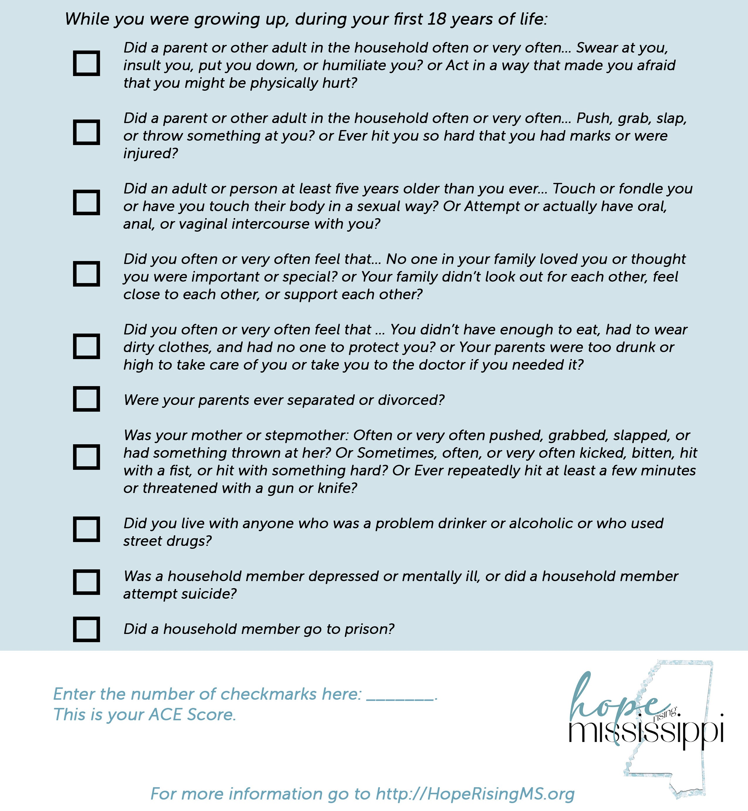
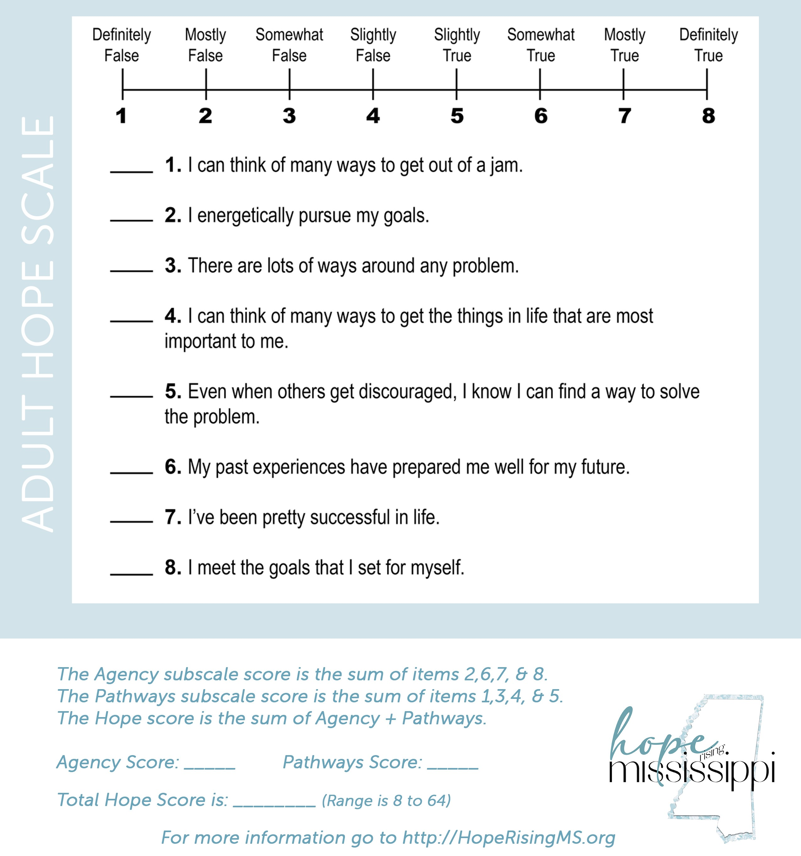
When you came in today, you received handouts that we are going to reference. Let’s take a moment and complete the ACEs and the Adult Hope Scale.
(We’ll use that information later in the presentation.)

Slide 5
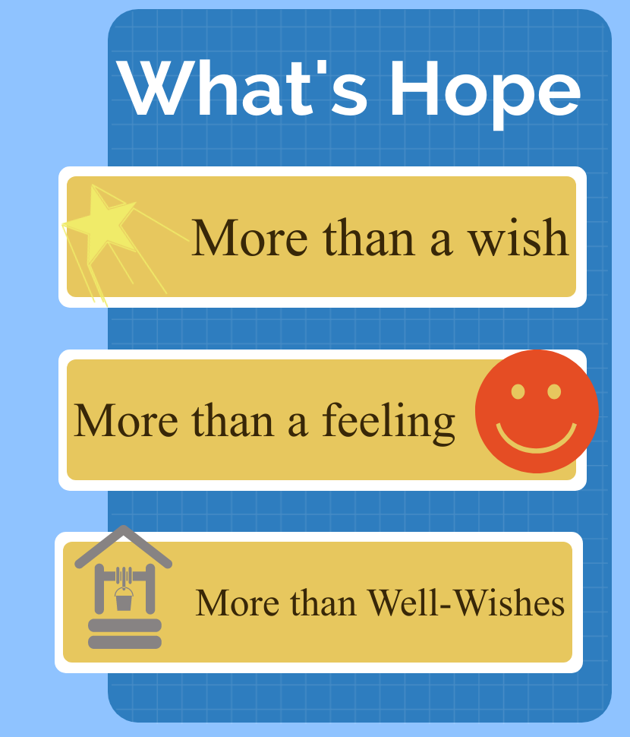
Notes:
So let’s get started!
If you are jotting down notes, I want you to write and underline this very simple point, “HOPE is a mitigating factor against adversity.” We will come back to this point time and time again this morning.
So, what is Hope? This has been at the center of arguments for a very long time. But towards the late 60’s there was a general idea of something driving some people… Was it motivation? No…. Was it Optimism? Nope. It was more than that … and it seemed more concrete than just goosebumps.
Truth is Hope is more than a Wish … which is better than me, because that’s exactly what I thought it was. Something you wished on somebody when they got sick, “I HOPE they get well.”
And it’s More than a Feeling... It’s not something you feel inside, feeling hopeful.
And it’s better than well-wishes for someone.

Slide 6
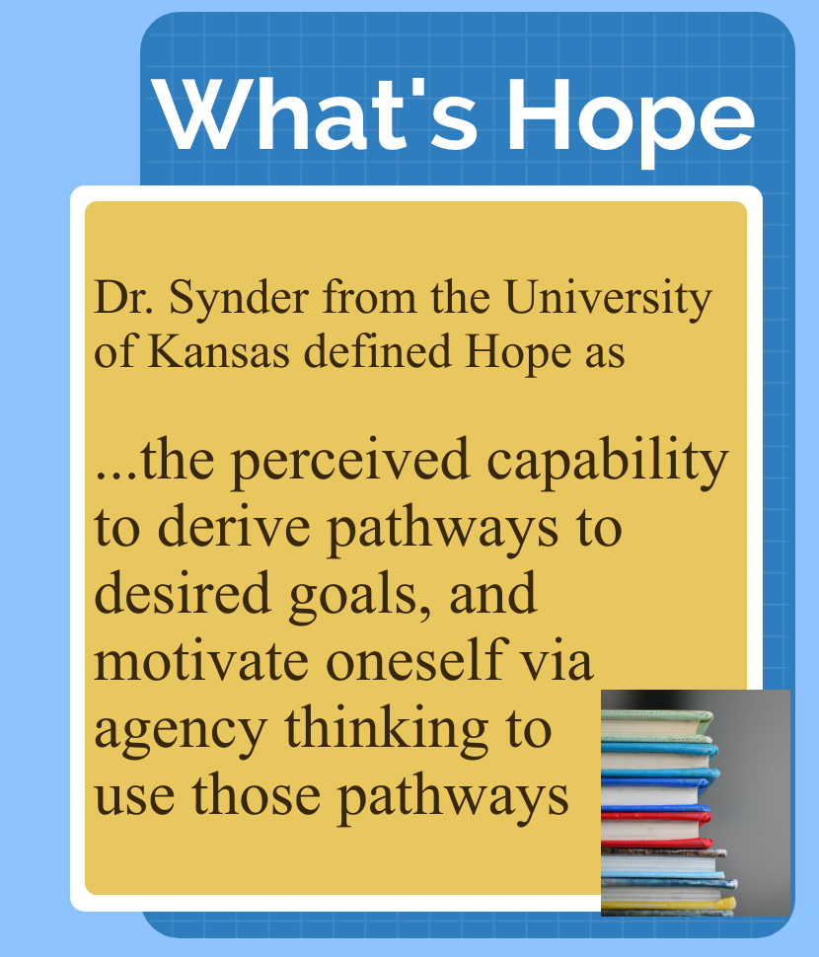
Notes:
Rick Snyder from the University of Kansas published in 1991 his definition of Hope.
In that landmark paper called Rainbows in the Mind, he defined what today we know as Hope Theory, “the perceived capability to drive pathways to desired goals, and motivate oneself via agency thinking to use those pathways.”
He said, it’s not about feelings; it’s not about wishing. Hope is something you do! It’s cognitive. It’s teachable. It can be broken down into steps and addressed with precision and detail.

Slide 7
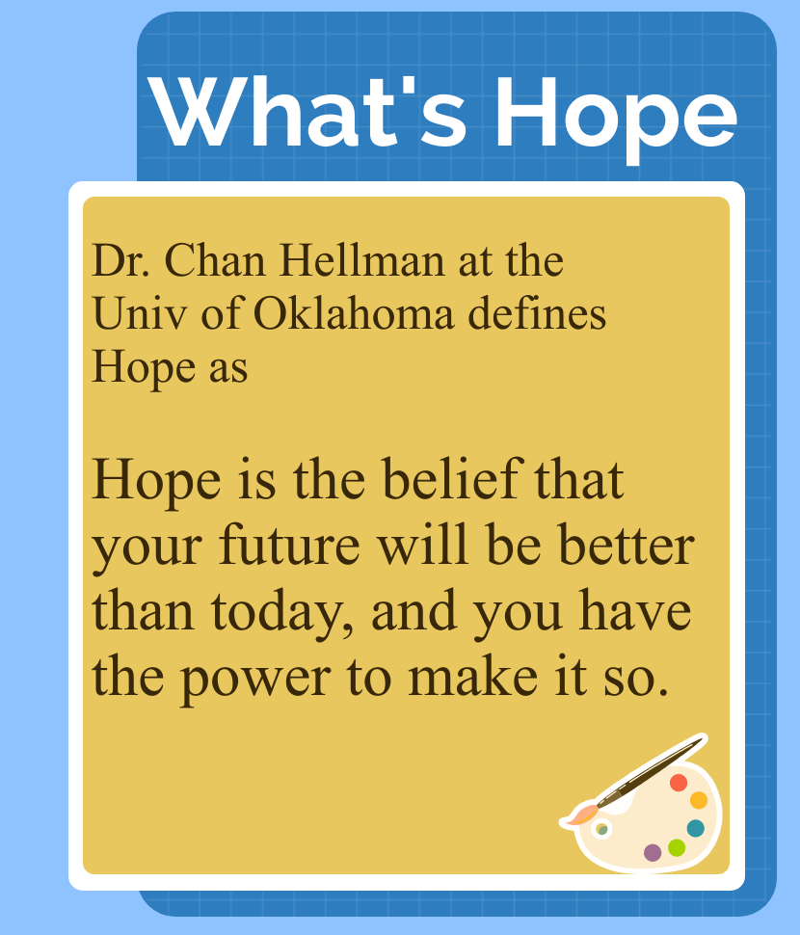
Notes:
Dr. Chan Hellman of the University of Oklahoma converts Synder’s definition into something that is easy to understand.
“Hope is the belief that your future will be better than today, and you have the power to make it so.”
And just like Synder, he breaks Hope down to three parts.

Slide 8

Notes:
Hope is:
Setting Goals
Identifying Pathways
and possessing Agency
It is these three simple (but not necessarily easy) steps!

Slide 9
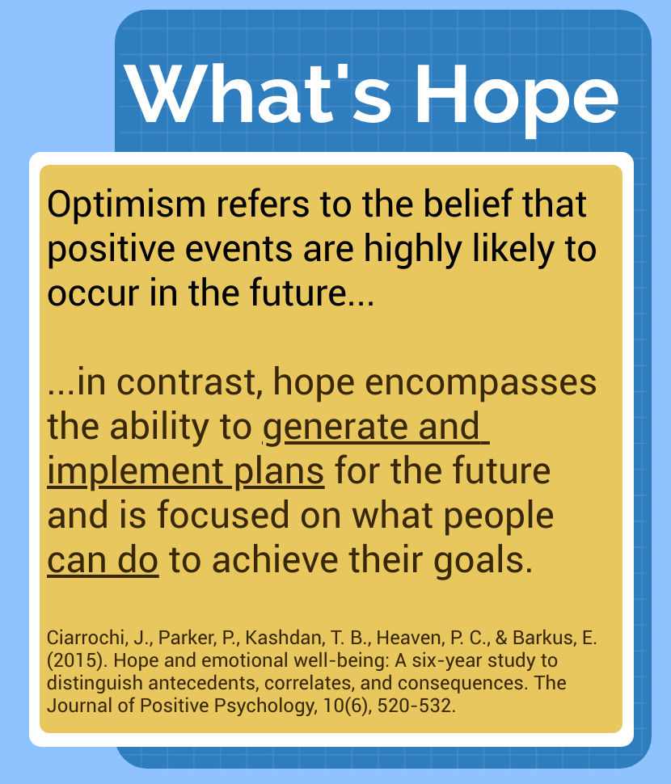
Notes:
But, isn’t this just a form of Optimism…
And the answer is NO! Optimism is just a belief of wish that something’s going to happen.
BUT for HOPE, there is cognitive investment.
Dr. Ciarrochi in his research on well-being delineates Hope by noting what Synder had already discovered that Hope is dependent on generating and implementing plans to achieve one’s goals.

Slide 10
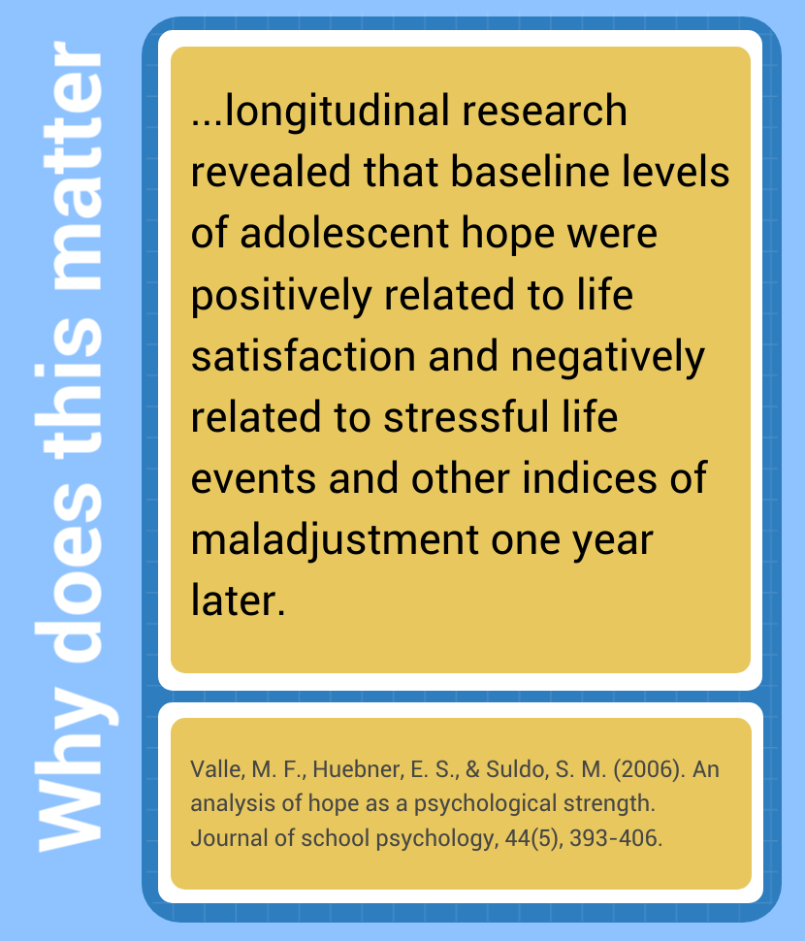
Notes:
So why does Hope matter? And how can knowing about Hope help you in your job role?
Michael Valle answers this questions very succinctly, “… Hope is positively related to life satisfaction and negatively related to stressful life events …”
Dr. Valle is just again confirming what researchers by this time were already stating, HOPE isn’t just about feeling positive, there’s some facet of this trait that helps people recover from some of life’s most challenging circumstances.

Slide 11
Hope is one of the best predictors of a child and family’s ability to thrive.
Notes:
Simply put, Hope matters, “It is one of the single best predictors of a child and family’s capacity to thrive.”
And study after study is coming to the same conclusions. Whether you are working with children or with adults.
The ability to look at the future and know it can and will be better than today is a game changer.
Here’s a question…
What would it look like to foster Hope in the lives of children impacted by trauma?
What results could we see in families, in communities as they become more Hope Focused?
How would it change the dynamics in our courts to put a priority Hope Focused solutions?
What about our schools?
How about throughout your agency? Your counseling strategies?
Did you know that research has shown that practitioners working to teach/train Hope are showing lower burn-out rates, have higher job satisfaction, and tend to manage stressful situations better? How might this affect the world where you currently work?

Slide 12
HOPE and ACEs
Notes:
Remember the phrase I asked you to remember?
Now is the time to talk about it.
“HOPE is a mitigating factor against adversity.”
Some of the more promising research has to do with Hope and Trauma.

Slide 13
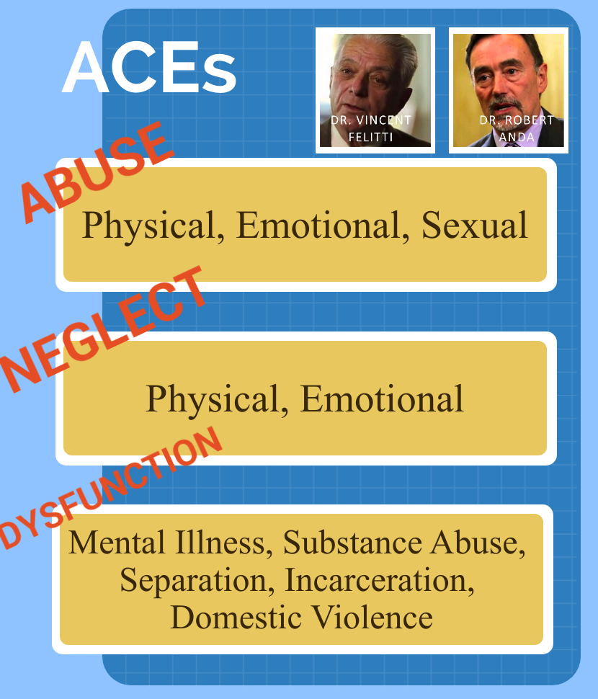
Notes:
If you're not familiar with the ACEs study or the adverse childhood experiences study you need to know that Dr. Feletti and Dr. Anda came up with this in the 1990s they really weren't looking for this. They were actually working on answering the question of why some people could lose weight and keep it off, and others, put it right back on.
They found that individuals struggling keeping their goals had some type of adverse event in their childhood. Now fast forward the research and add 17,500 people later and we have the ACE’s. Their research has produced a wealth of information and understanding. And while no research is perfect, the correlation between ACE’s and behavior is extremely strong.

Slide 14
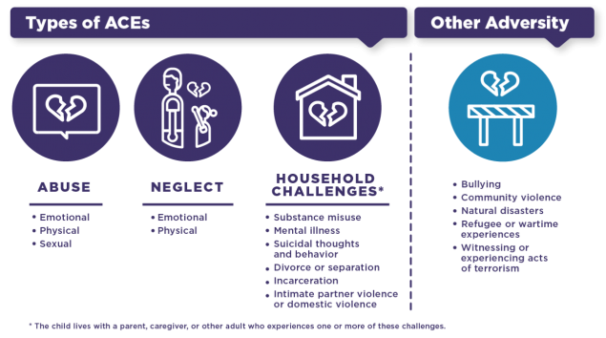
Notes:
They identified 10 areas and classified those into 3 silos.
The first silo is Abuse: it encompasses physical, emotional, and sexual abuse.
The next silo is neglect: whether it was physical or emotional, both had grave effects.
The last silo is household dysfunction: examples are mental illness, substance use disorder, relationship issues, or violence.
As research continues, other types of adversity are being added to the silos such as Natural Disasters or Community Violence.

Slide 15
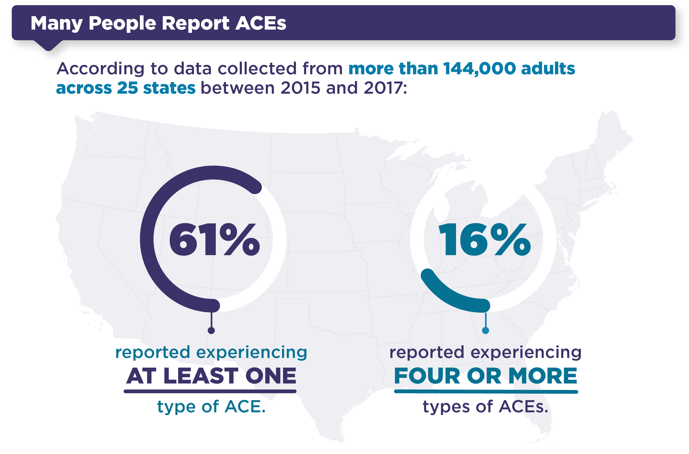
Notes:
And according to data we collected PRIOR to the pandemic … and with the assumption that it is believed to have risen during these lockdown periods, we know that at least 61% of the US is reporting at least ONE ACE.
But more disturbing is the 16% reporting FOUR or MORE.

Slide 16
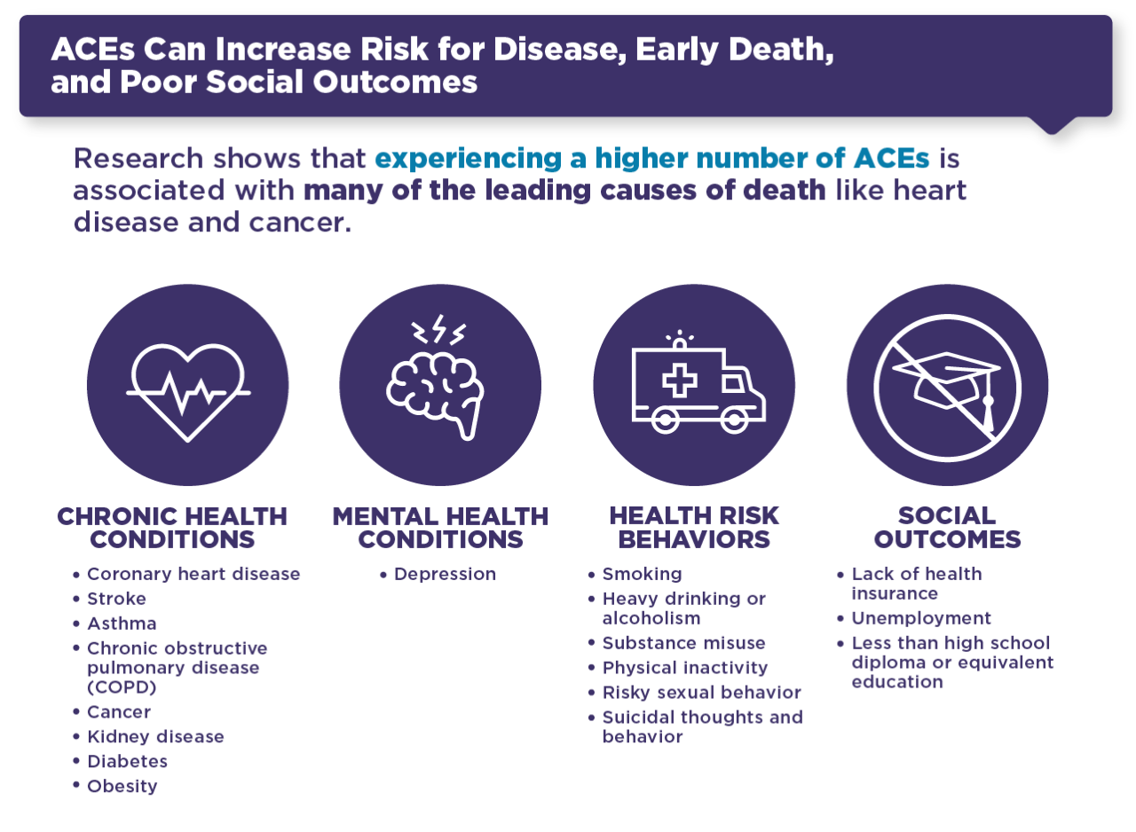
Notes:
The effects of these traumatic events are having lasting health implications: PHYSICALLY, MENTALLY, and SOCIALLY.

Slide 17
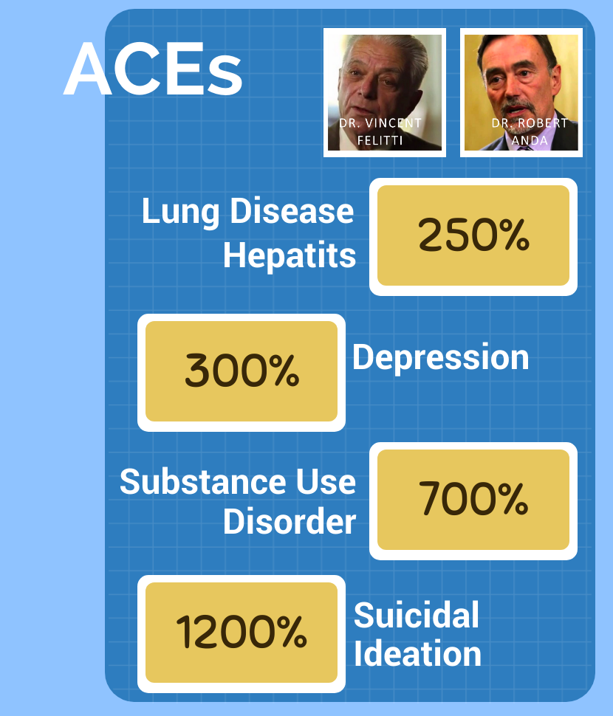
Notes:
Take these numbers for example. Research is clear there is a dosage relationship between the ACEs score and multiple, seemingly unrelated items. The higher the ACE Score, the more likely one is to experience these problems.
And if you are one of those with a score of 4 or more – here are the devastating effects:
You have a 250 percent higher chance of developing lung disease, you’re 3 times more likely to develop clinical depression, 12 times more likely to consider suicide… And something we all know too well – you are 7x more likely to develop Substance Use Disorder
And if your score is 6 or more? You can take an average of 20 years off of your life.

Slide 18
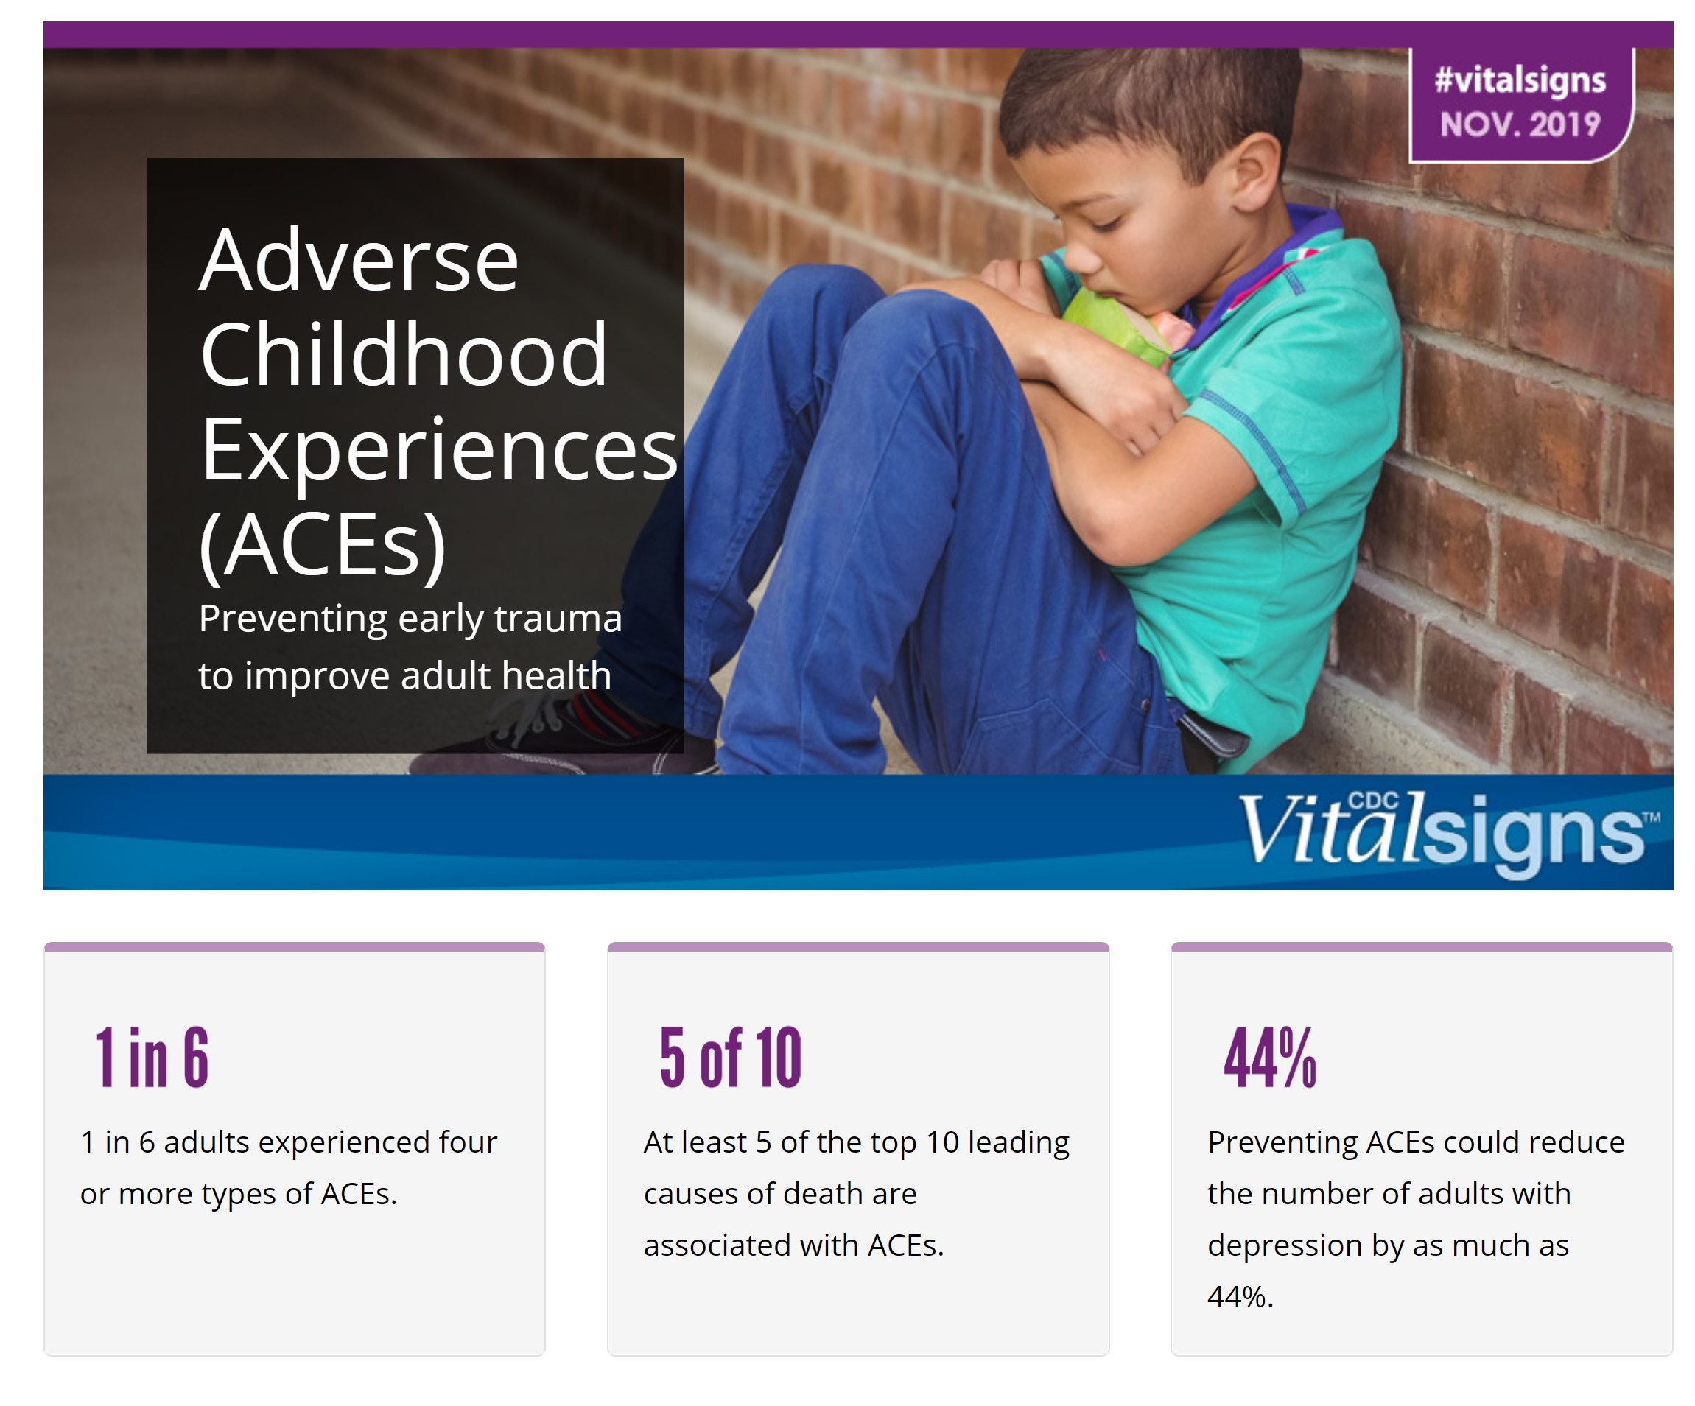
Notes:
5 of the top 10 leading causes of death have strong correlations with ACEs scoring.
Heart disease: 696,962
Cancer: 602,350
COVID-19: 350,831
Accidents (unintentional injuries): 200,955
Stroke (cerebrovascular diseases): 160,264
Chronic lower respiratory diseases: 152,657
Alzheimer’s disease: 134,242
Diabetes: 102,188
Influenza and pneumonia: 53,544
Nephritis, nephrotic syndrome, and nephrosis: 52,547

Slide 19
Where were you on the ACE?
Notes:
Where were you on the ACEs?
(Do not raise your hands)

Slide 20
“Adverse childhood experiences are the single greatest unaddressed public health threat facing our nation today.”
Notes:
President of the American Academy of Pediatrics, Bob Block stated, “Adverse childhood experiences are the single greatest unaddressed public health threat facing our nation today.”
And this is true in Mississippi as well, with massive rates of childhood obesity, violence inside and outside the homes, and the shear number of kids you face on your jobs every day!
Something must be done!

Slide 21
Where were you on the AHS?
Notes:
Where were you on the Adult Hope Scale?
With the Adult Hope Scale, scores of 40 or above put an adult in a hopeful category.
Scores above 48 bump you up to a higher level of hope.
Scores of 56 or higher make you a high hope person.
Scores below 40 put you in a low hope category. Don’t panic if you have low hope right now in your life. It just means you have work to do.

Slide 22
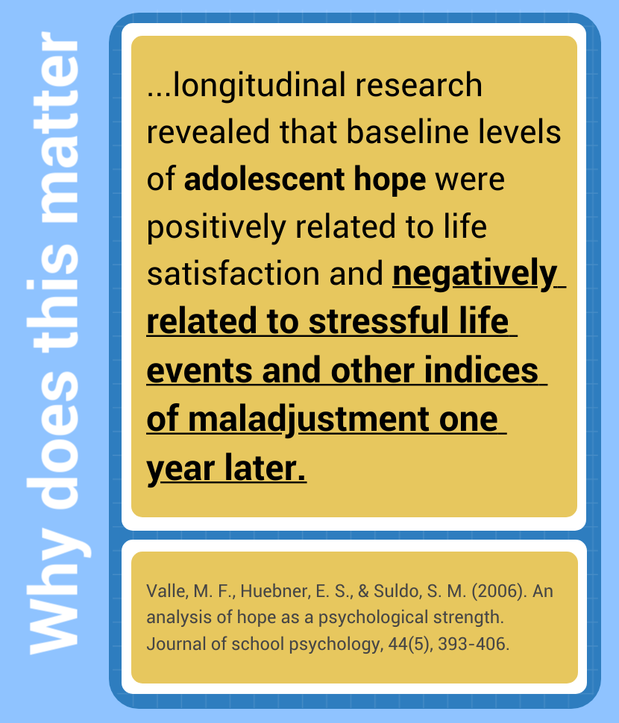
Notes:
Remember the Valle study from before?
When we introduce HOPE, there is not only a positive relationship with life satisfaction, but there is a negative relationship to stressful life events.
For example, Munoz and his team, researchers at the University of Oklahoma, found in domestic violence situations, HOPE is linked to a sense of empowerment and life satisfaction… among the homeless, lower levels of pain and greater feelings of health… and Dr. Hellman found among children in foster care, hope is positively correlated with self-control, grit, and curiosity.

Slide 23
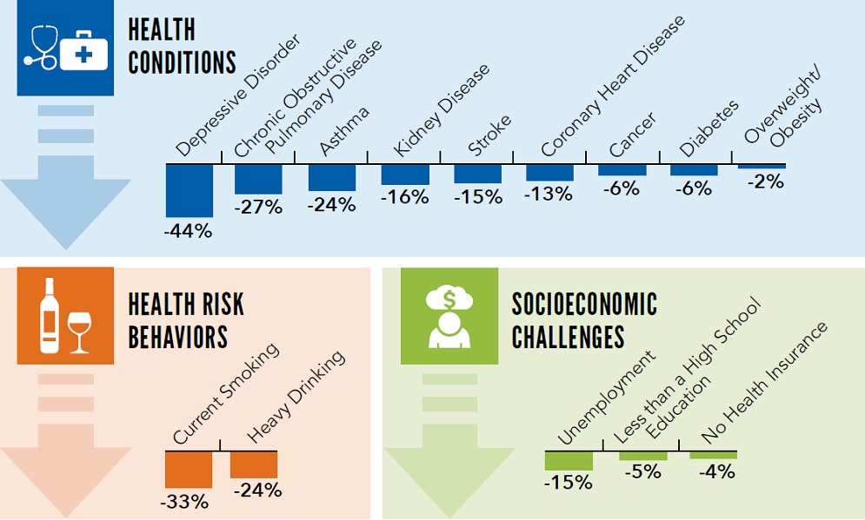
Notes:
And there are health benefits as well. Mitigating ACEs with Hope produced a 44% drop in depression rates, 24% lower incidents of asthma, even a 6% drop in diabetes.
Consequentially it also reduced smoking and drinking behaviors, and unexpectedly lowered unemployment and increased school retention.
In fact, increased Hope scores have the ability to raise student’s academic performance between one and two letter grades!

Slide 24
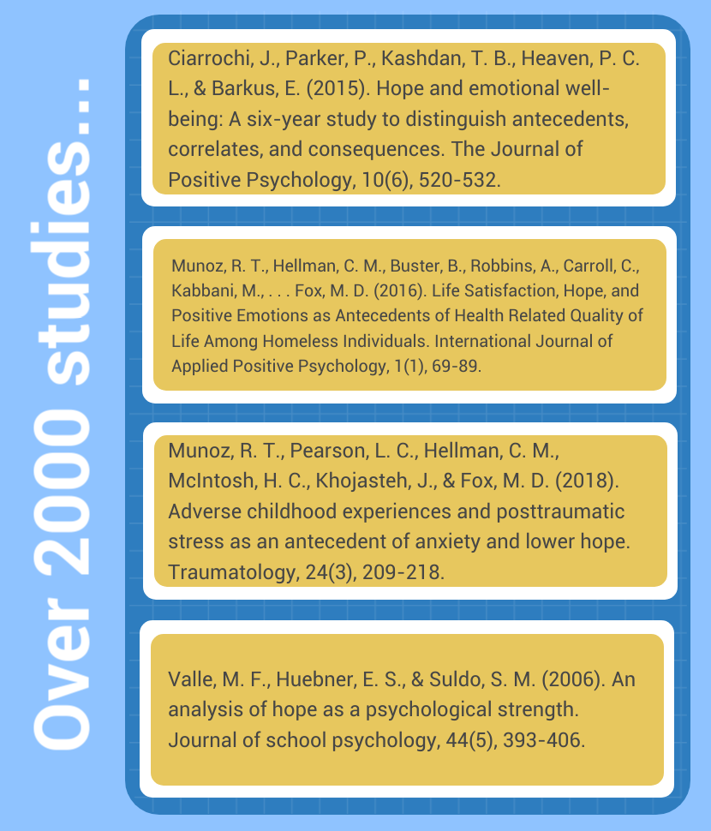
Notes:
Studies after studies are confirming these results. Dr. Chan in 2019 noted that in as few as 4 one-hour sessions, cancer patients were reporting psychological benefits and increased states of well-being.
JUST BY USING WHAT WE LEARNED TODAY.
Three Steps …
Identify Goals
Map out Pathways
Develop strong Agency

Slide 25
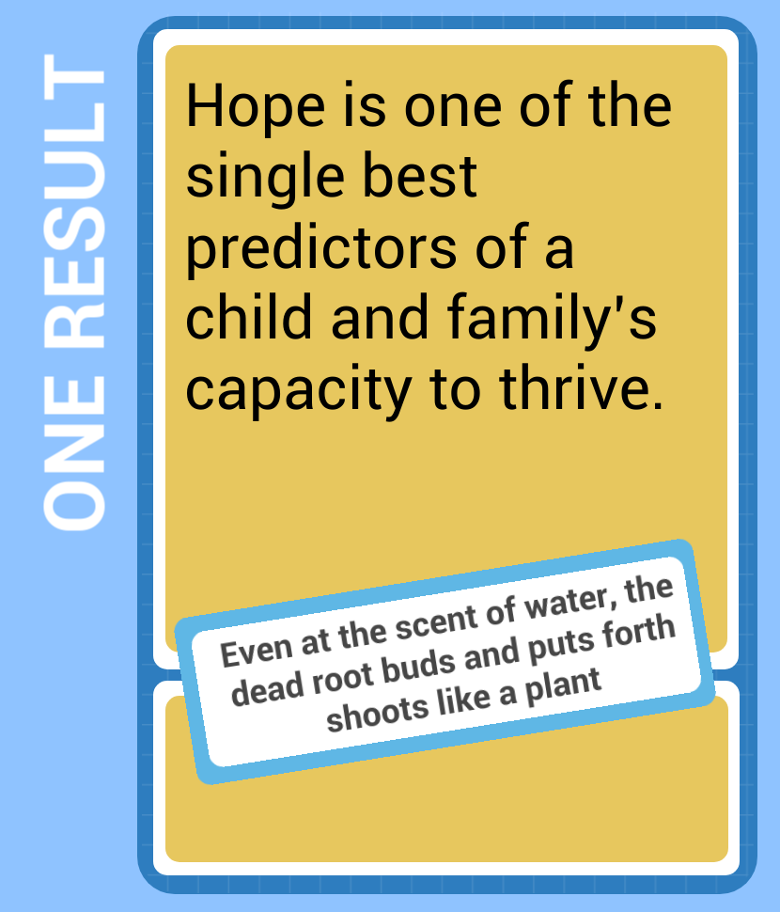

Slide 26
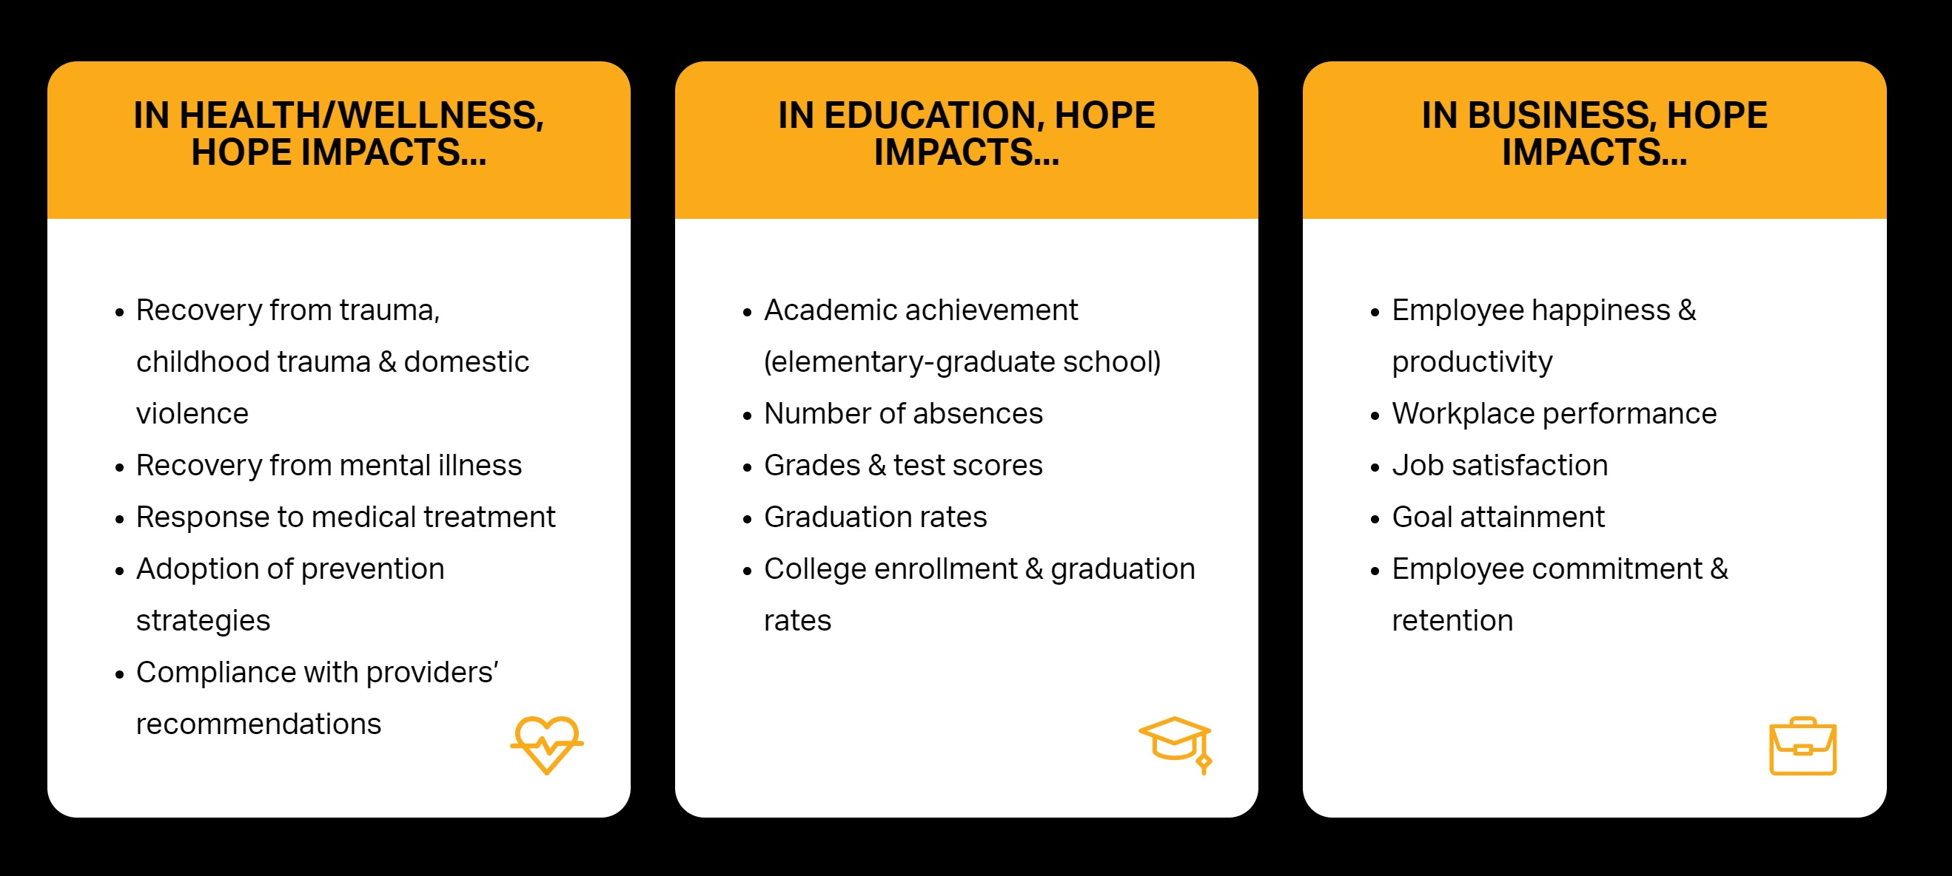
Notes:
By increasing one’s Hope, we effect multiple domains simultaneously in persons lives!

Slide 27
Hope and Substance Use Treatment
Notes:
But what about CPS?
What are some of the places you could use Hope?
Let’s begin by looking at just some of the simultaneous relationships you must maintain to do your jobs effectively.

Slide 28
Hope and Providers
Often we maintain multiple simultaneous relationships
Courts
Children
Households
Treatment
Outside Resources
Support Agencies
Within our own Agency
Notes:
Working in this field, you must maintain multiple relationships … and trying to balance those are next to impossible.
And while this certainly isn’t an exhaustive list … it doesn’t mean that your jobs aren’t completely exhausting. The number of plates you have to keep in the air at one time to work with some of the State’s most vulnerable is untenable to most … AND yet you do it.

Slide 29
Hope and Providers
Courts
Children
Households
Treatment
Outside Resources
Support Agencies
Within our own Agency
Each of these relationships can be affected by the HOPE framework
Notes:
And what I can tell you is this …
Each of these relationships are affected by the Hope Framework.

Slide 30
Hope and Providers
Courts
Children
Households
Treatment
Outside Resources
Support Agencies
Within our own Agency
By instituting HOPE framework with children, you build resilience, grit, well-being
Notes:
For example, with children, research shows by setting appropriate goals, facilitating pathways, and awarding agency, we can help children build grit, self-esteem, and resiliency. Short term goals become long term achievements.

Slide 31
Hope and Providers
Courts
Children
Households
Treatment
Outside Resources
Support Agencies
Within our own Agency
By instituting HOPE framework with households, you address barriers and the ability to redirect and respond
Notes:
In households, using the Hope Framework, we can build rapport, locate barriers, and teach pathways thinking to go around obstacles. These types of interactions empowers family units to continue to achieve long after cases have been closed.

Slide 32
Hope and Providers
Courts
Children
Households
Treatment
Outside Resources
Support Agencies
Within our own Agency
By instituting HOPE framework with courts, your reporting becomes focused on goal setting, with better notations to household challenges
Notes:
Hope Framework even affects the interactions within the courtroom. Progress monitoring becomes less dispensational, and more achievement orientated. Through the framework process, family units are better equipped to address household challenges, and the reports are significant and measurable.

Slide 33
The Hope Framework also impacts your practice
Courts
Children
Households
Treatment
Outside Resources
Support Agencies
Within our own Agency
Hope and Practice
Notes:
In addition to relationships between other agencies, there are real affects of using the Hope Framework within the counseling relationship as well.

Slide 34
Like Wilson et al., who found an association between hopefulness and alcohol, tobacco, and drug use in a group of at risk middle school students, we also found that hope is associated with decreased likelihood for substance use for high-school aged marginalized youth
(Wilson, Syme, Boyce, Battistich, & Selvin, 2005).
Courts
Children
Households
Treatment
Outside Resources
Support Agencies
Within our own Agency
Hope and Practice
Notes:
One of the most convincing studies looks at kids in high risk environments …
Hope was demonstrated to be a mitigating factor not just after first use, but a decrease in likelihood of first use!
Certainly a goal of every prevention provider.

Slide 35
In residential treatment settings, hope has been associated with better quality of life, greater social support from friends and family, and longer duration of abstinence.
(Irving, Seidner, Burling, Pagliarini, & Robbins-Sisco, 1998; see also Mathis, Ferrari, Groh, & Jason, 2009)
Courts
Children
Households
Treatment
Outside Resources
Support Agencies
Within our own Agency
Hope and Practice
Notes:
Hope is the supporting factor of the goals we are already attempting to achieve …
Increasing Well-being, tightening support systems, and providing for longer periods of abstinence.
AND THIS IS JUST BY INSTITUTING A HOPE FRAMEWORK

Slide 36
The inclusion of hope in clinical practice shows considerable promise.
Hope has been found to be related to readiness to change and healthy coping skills.
In kids at high risk for engaging in substance use, higher hopefulness appears to be associated with greater likelihood of never using marijuana.
Individual, group, and family therapy interventions that incorporate hope theory have been found to reduce symptomology and mediate recovery from various psychological and psychosocial conditions
Study after study is saying the same thing…
Notes:
Studies are all pointing to the same conclusion:
The inclusion of hope in clinical practice shows considerable promise.
Hope has been found to be related to readiness to change and healthy coping skills.
In kids at high risk for engaging in substance use, higher hopefulness appears to be associated with greater likelihood of never using marijuana.
Individual, group, and family therapy interventions that incorporate hope theory have been found to reduce symptomology and mediate recovery from various psychological and psychosocial conditions

Slide 37
HopeWorks
Notes:
HOPE WORKS!

Slide 38
But where there's hope, there is life. It fills us with fresh courage and makes us strong again."
Anne Frank's entry, June 6, 1944
Notes:
But where there's hope, there is life. It fills us with fresh courage and makes us strong again."
Anne's entry, June 6, 1944

Slide 39

MsAAP.net

